Slide 1



DEPARTMENT OF INFORMATION SCIENCE AND ENGINEERING
PROJECT PHASE I- PRESENTATION
ON
Biometric Authentication using
2 step verification
TEAM MEMBERS:
1.MITHUN Y(1CE22IS030)
2. MOHAMMED ARMAN ALI(1CE22IS031)
3.NAND KISHORE MALAVIYA(1CE22IS034)
4. SATHYADRI S(1CE22IS049)
UNDER THE GUIDANCE OF :
DR. ANITHA PATIL

Slide 2

CONTENTS
INTRODUCTION
LITERATURE SURVEY
PROBLEM STATEMENT
EXISTING SYSTEM
PROPOSED SYSTEM
SOFTWARE REQUIREMENT SPECIFICATIONS
DESIGN /FUNCTIONAL MODULES
GANTT CHART
REFERENCES

Slide 3
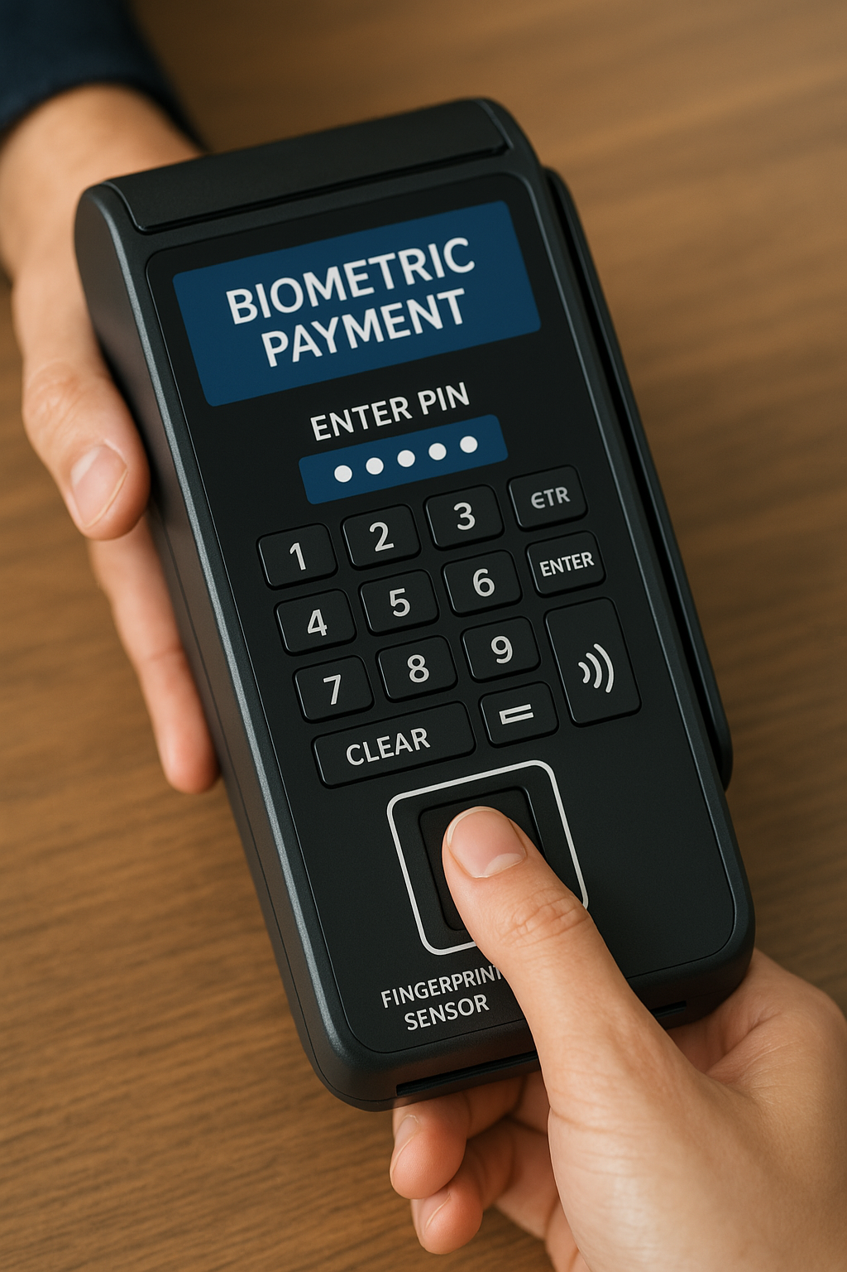
INTRODUCTION
Biometric Fingerprint Payment Systems are secure and innovative payment methods that use fingerprint recognition combined with a 5-digit PIN code to authenticate and authorize financial transactions.
This system captures the user’s fingerprint using specialized sensors and verifies it against stored biometric data, while simultaneously prompting the user to enter a personal 5-digit PIN to complete the transaction.

Slide 4
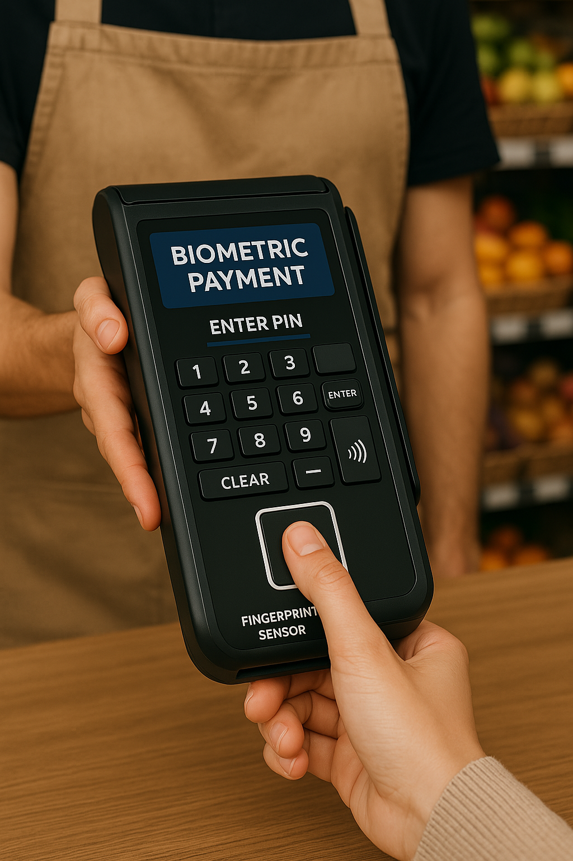
The combination of biometric verification and PIN authentication reduces the risks of unauthorized access due to stolen cards, fingerprint spoofing, or PIN guessing alone, thus offering an extra layer of protection.
As technology advances, the integration of biometric fingerprint recognition with PIN codes is expected to become a standard for secure digital payments, enhancing trust and safety across various payment platforms worldwide.

Slide 5
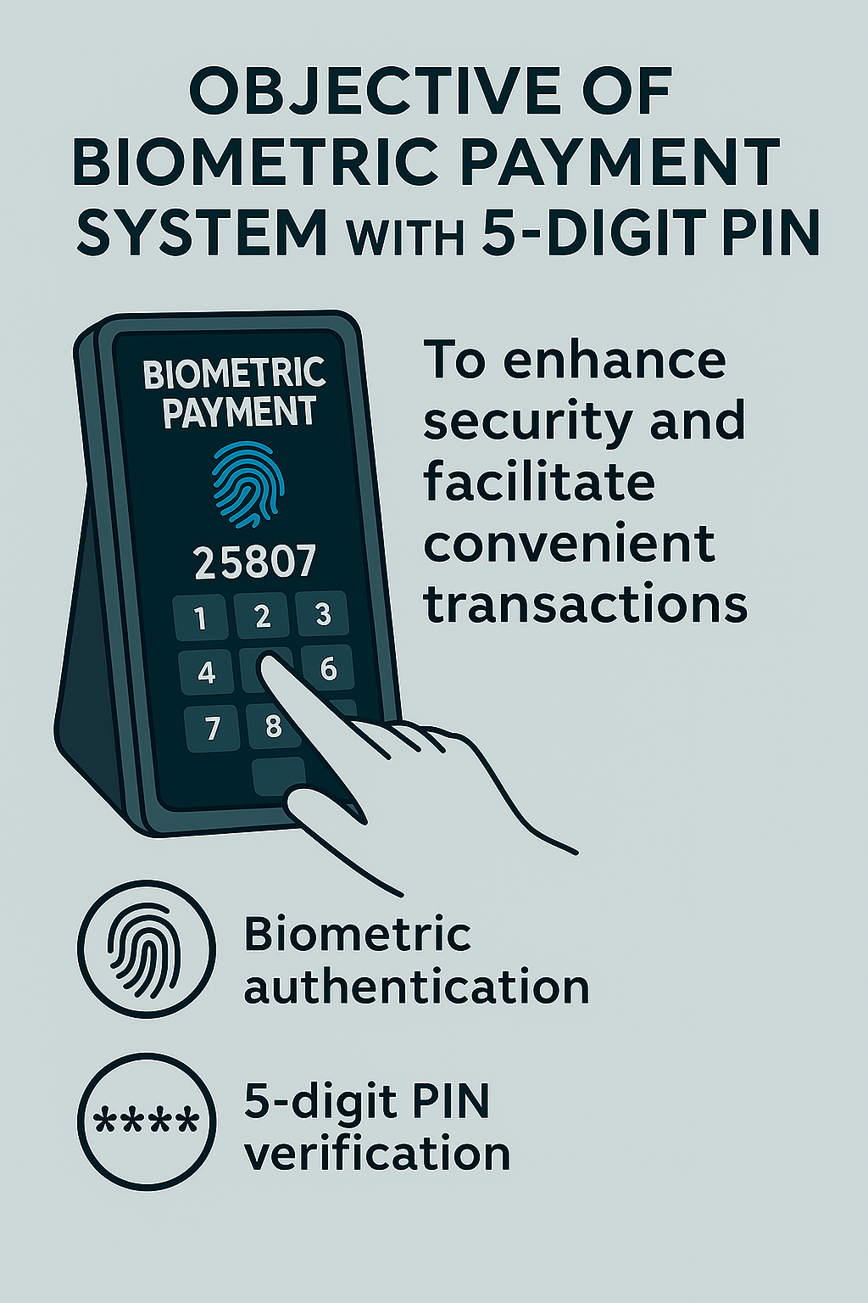
Objectives of Work
Why This Project?
Develop a secure & efficient payment system using fingerprint authentication + PIN
Implement multi-factor authentication to enhance security & prevent unauthorized access
Ensure encrypted storage & transmission of biometric/payment data to protect user privacy
Integrate with payment gateways for seamless real-time transactions across platforms
Design a user-friendly & accessible interface for diverse users
Advance biometric + PIN-based authentication to foster trust & adoption in digital payments

Slide 6

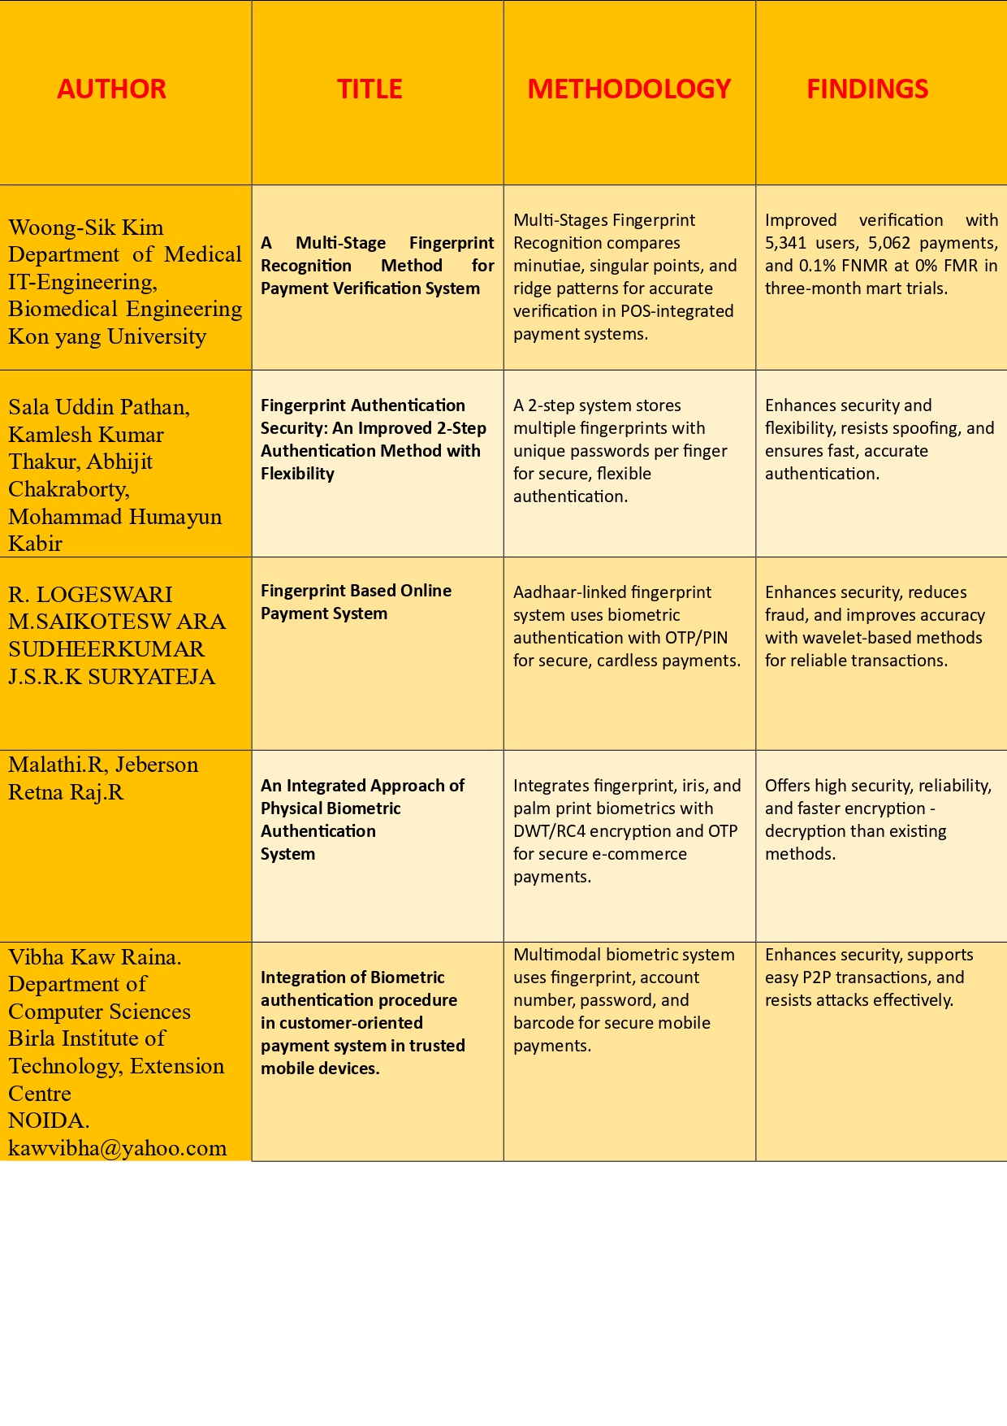
LITERATURE SURVEY

Slide 7
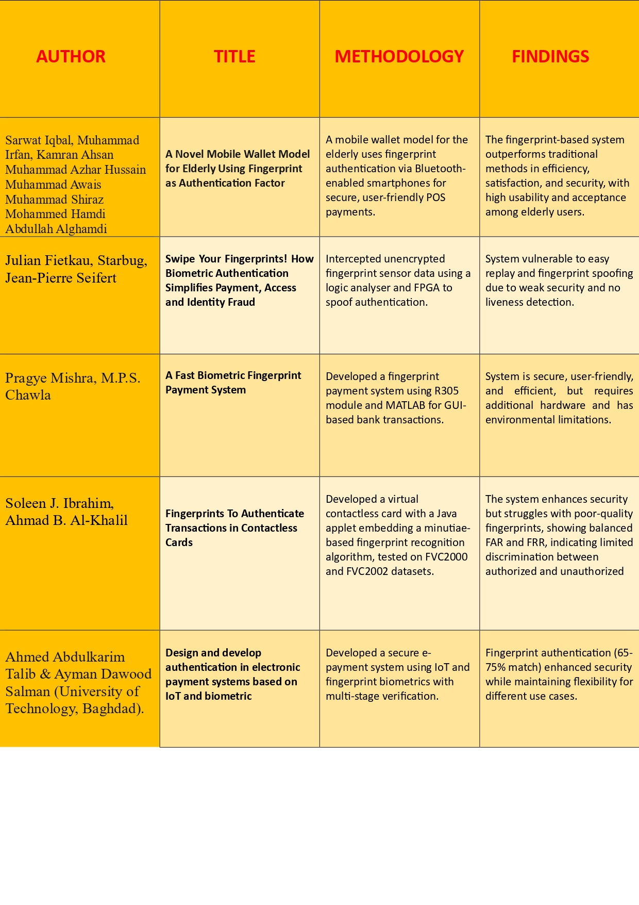

Slide 8
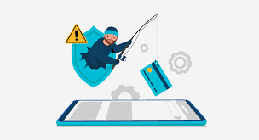
PROBLEM STATEMENT
Traditional payment methods relying solely on PIN codes or physical cards are vulnerable to fraud, theft, and unauthorized access. Single-factor authentication, such as card swiping or PIN entry alone, poses security risks due to stolen credentials, card cloning, and PIN guessing attacks.
To address these concerns, this project aims to implement a biometric fingerprint payment system that integrates multi-factor authentication, requiring both fingerprint verification and a 5-digit PIN for transaction authorization. The challenge lies in ensuring high accuracy, secure data storage, encrypted transmission, and seamless integration with payment gateways while maintaining ease of use and accessibility for diverse users.

Slide 9
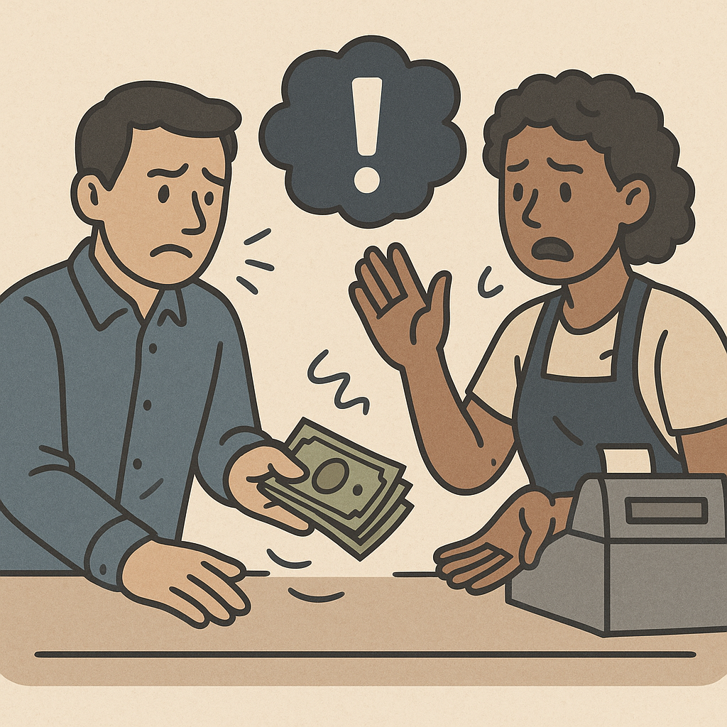
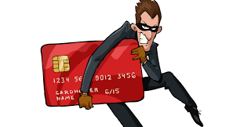
EXISTING SYSTEMS
1. Cash Transactions
Traditional method using physical currency
No digital security risks, but prone to theft and
counterfeiting
Limited in online and remote transactions
2. Credit & Debit Card Payments
Widely used in retail and online purchases
Requires PIN or signature for authentication
Vulnerable to card theft, skimming, and fraud

Slide 10
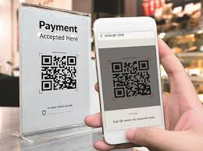
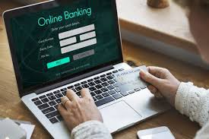
EXISTING SYSTEMS
3. Mobile & Digital Wallets
Examples: Google Pay, Apple Pay, Paytm
Uses NFC (Near-Field Communication) or QR codes for transactions
4. Online Banking & UPI Payments
Examples: Net banking, PayPal, UPI (Unified Payments Interface)
Enables direct transactions between bank accounts
Secured by OTP (One-Time Password), PIN, and two-factor authentication

Slide 11
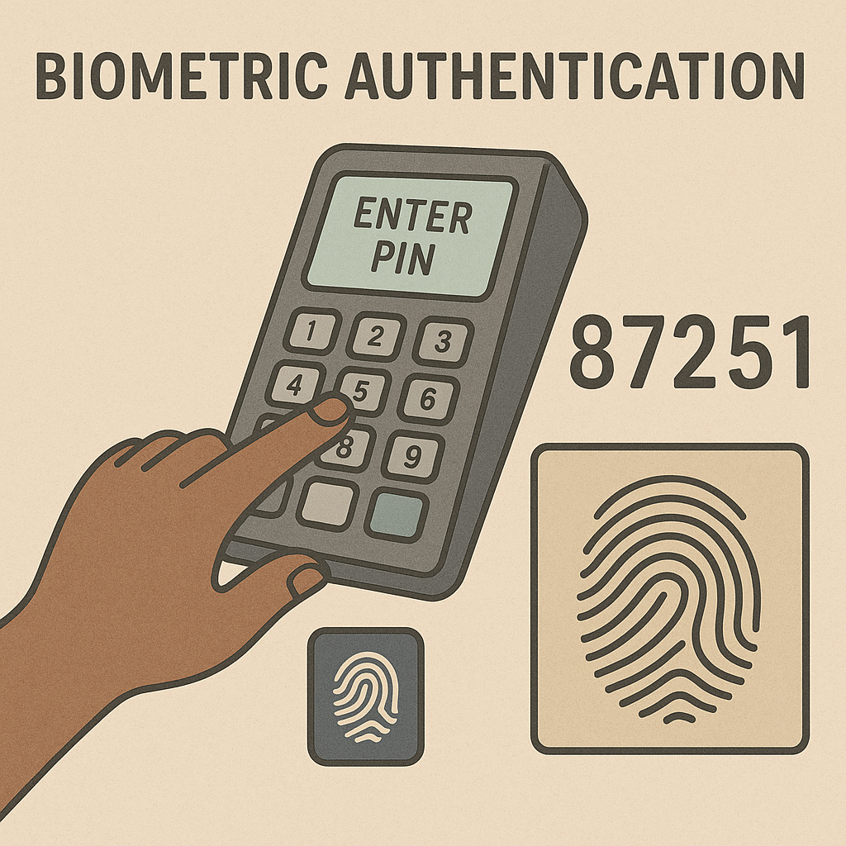
PROPOSED SYSTEM
Biometric Fingerprint Payment System involves several key steps that ensure secure, accurate, and efficient authentication and payment processing. The process includes:
Fingerprint Enrollment – Users initially register their fingerprint by scanning it through a fingerprint sensor. The system captures the fingerprint image, processes it to extract unique features, and securely stores the biometric template along with the associated user data. PIN Code Setup – Along with fingerprint enrollment, users set up a personal 5 digit PIN code, adding a second layer of authentication to enhance security.
Authentication – During payment, the user places their finger on the fingerprint sensor. The system captures the fingerprint and compares it with stored templates to verify identity. Simultaneously, the user is prompted to enter their 5-digit PIN code. Both factors must be validated to authorize the transaction.
Payment Authorization – Once biometric and PIN verification succeed, the system communicates securely with a payment gateway via encrypted channels to process the transaction in real-time.

Slide 12
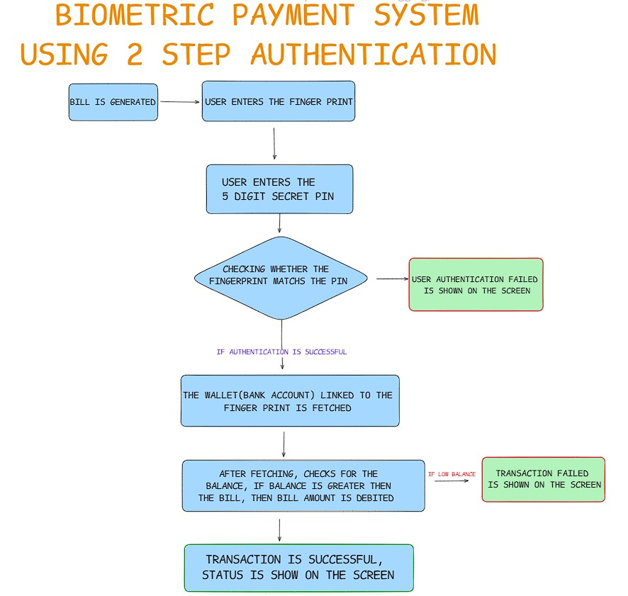
BLOCK DIAGRAM

Slide 13
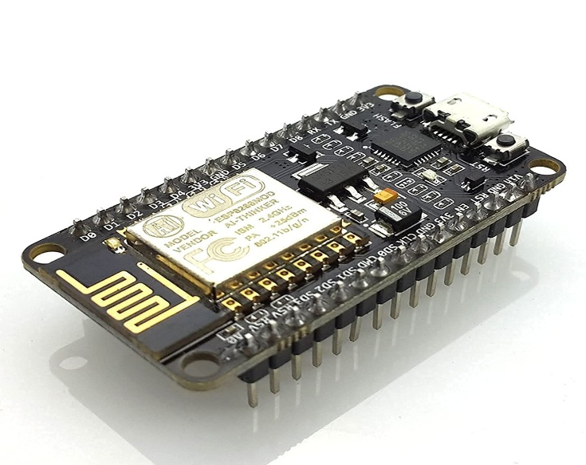
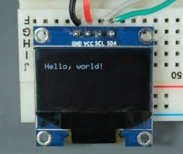
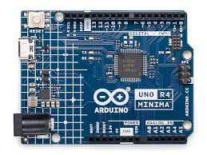
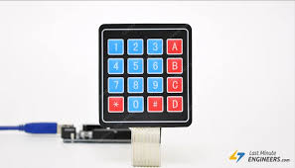
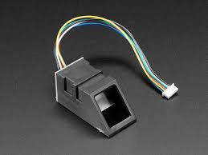
HARDWARE REQUIREMENTS

Slide 14
💻 SOFTWARE REQUIREMENTS
Database & Backend Architecture
Secure storage of user credentials and transaction history
Support for relational (SQL) or NoSQL databases
API Integration
RESTful APIs for communication with banking/payment gateways
Third-party biometric service providers (e.g., Face ID, fingerprint recognition SDKs)
Arduino IDE
Java for backed services
C/C++ for embedded firmware development and sensor interfacing.
SDKs provided by fingerprint sensor manufacturers or open-source
libraries for fingerprint image processing and matching.
HTTPS for secure communication with payment servers.
MQTT or WebSocket protocols if real-time communication is required.

Slide 15
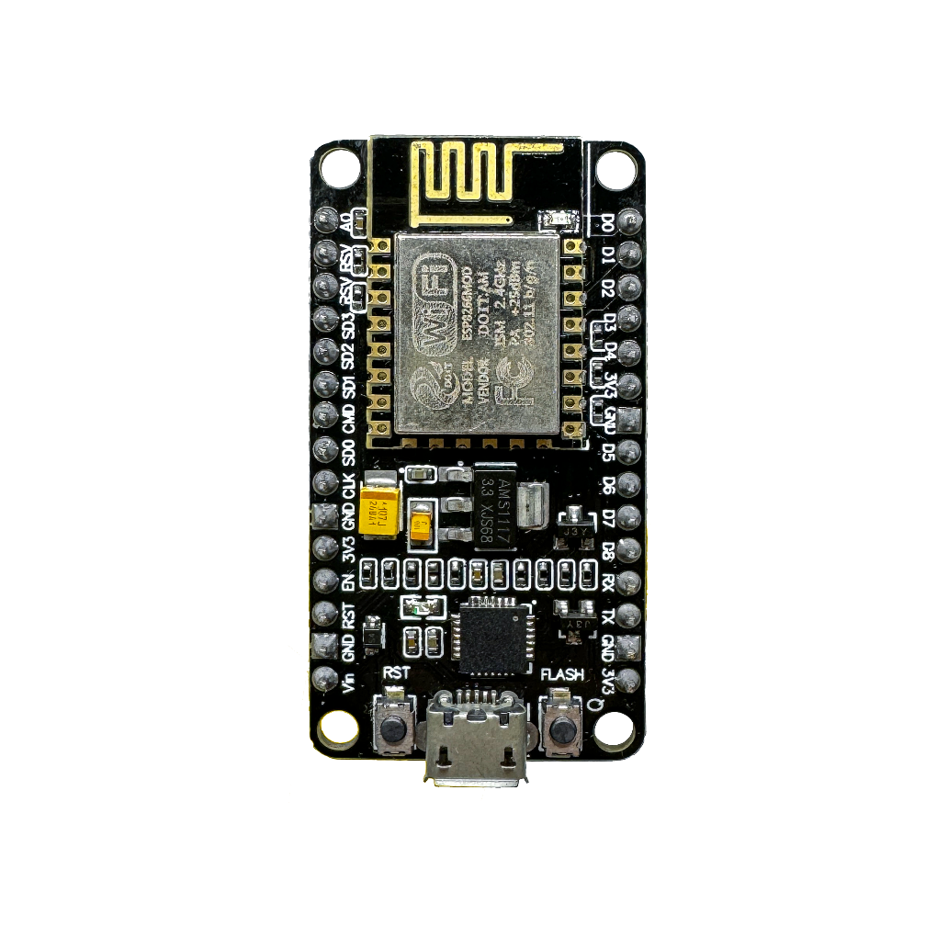
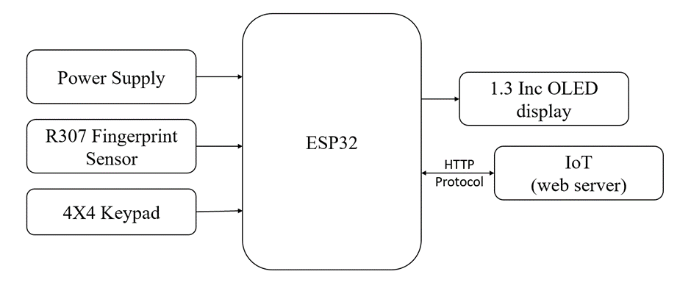

Slide 16
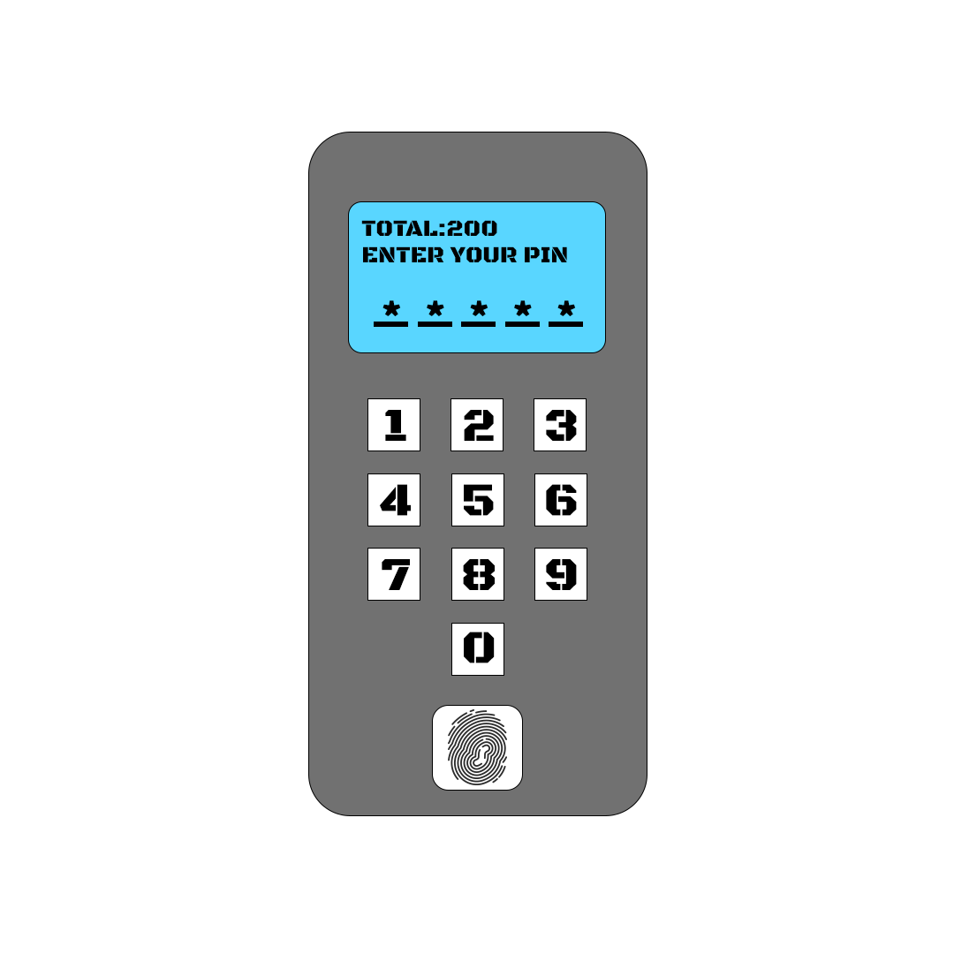
Model Diagram (Conceptual)

Slide 17
APPLICATIONS
Retail store– Stores integrating biometric authentication to allow customers to pay using fingerprints, reducing fraud and making transactions seamless.
Banking and Financial Services – Banks use biometric systems for secure transactions, ensuring that only authorized individuals can access financial services.
Transportation and Ticketing – Public transport systems and airlines are adopting biometric payments for ticket purchases and boarding passes, eliminating the need for physical tickets or cards.
Hospitality and Travel – Hotels and resorts are using biometric systems for check-ins, room access, and payments, making travel experiences smoother.

Slide 18
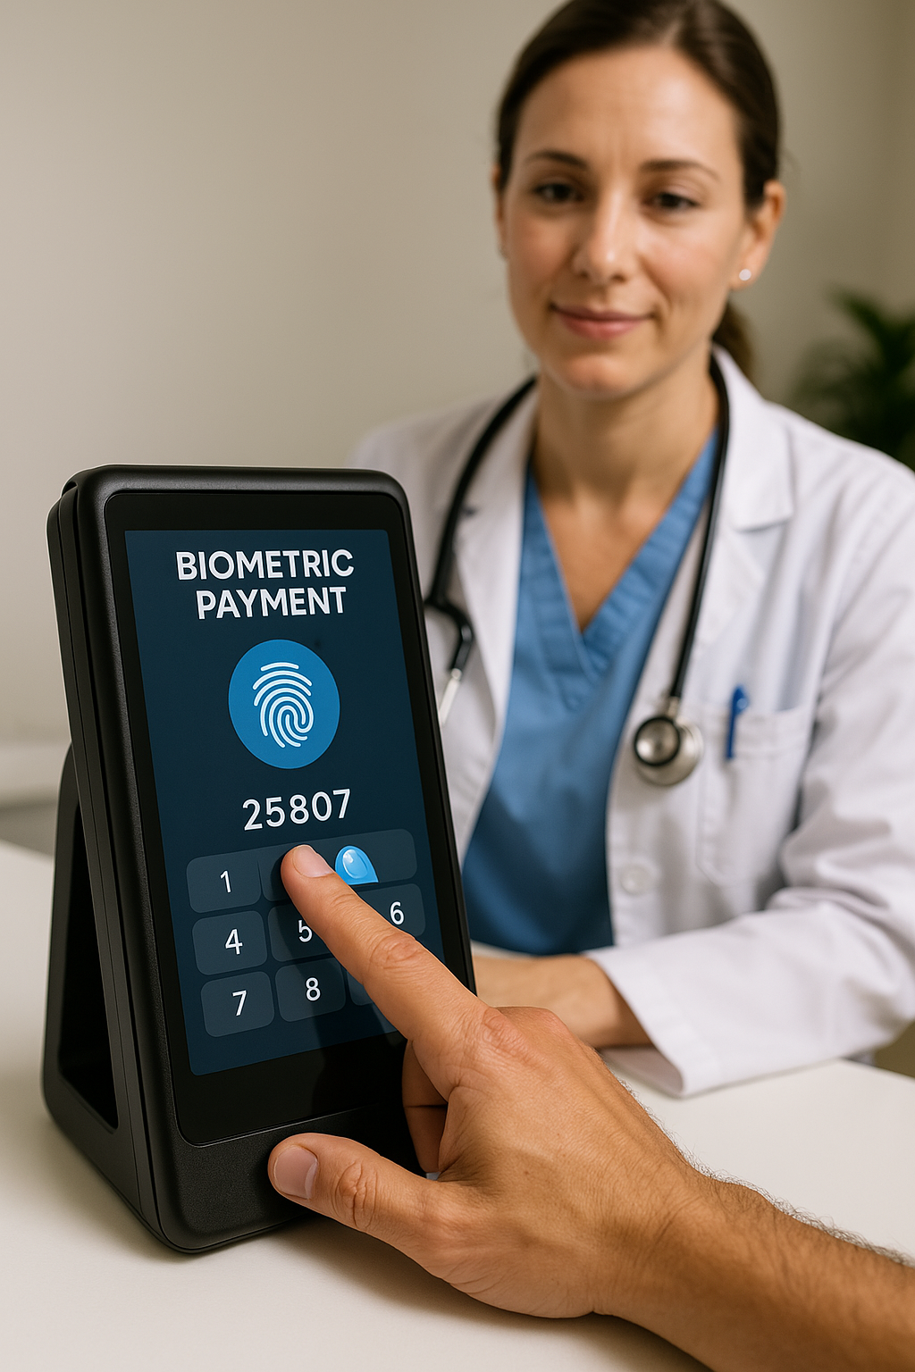
Healthcare and Insurance – Biometric payment systems in hospitals and clinics streamline billing processes, ensuring quick and secure patient payments.
Workplaces and Access Control – Some companies use biometric payment systems in cafeterias and vending machines, allowing employees to make purchases with their fingerprint.
Gaming and Entertainment – Casinos, theme parks, and event venues implement biometric payments for fast and secure transactions, improving customer experience.

Slide 19
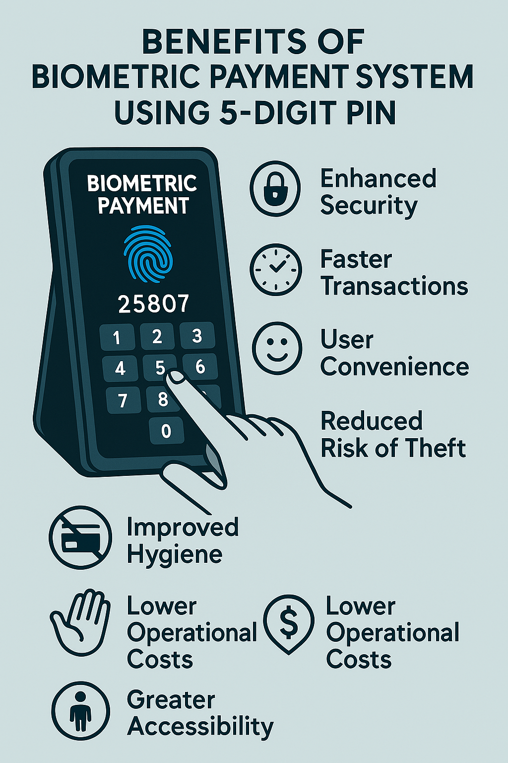
BENEFITS
Enhanced Security – Biometrics ensure that only the registered user can authorize transactions, reducing fraud and unauthorized access. The 5-digit PIN adds an extra layer of protection.
Faster Transactions – No need to carry cards or cash. Payments are processed instantly, improving efficiency in retail, transportation, and other services.
User Convenience – Customers don’t have to remember complex passwords or carry multiple payment cards—just their biometric data and PIN.

Slide 20
Reduced Risk of Theft – Since transactions require biometric authentication, stolen cards or credentials become useless to fraudsters.
Improved Hygiene – In a world moving toward contactless interactions, biometric payment systems minimize physical touch, reducing the spread of germs.
Lower Operational Costs – Businesses can cut costs on card management and cash handling by adopting biometric payments.
Greater Accessibility – Individuals who may struggle with handling cards or cash (e.g., elderly users) find biometric systems more intuitive and user-friendly.

Slide 21
REFERENCES
[1] S. J. Ibrahim and A. B. Al-Khalil, “Fingerprints to Authenticate Transactions in Contactless Cards,” Science Journal of the University of Zakho, vol. 11, no. 4, pp. 481–491, Oct.–Dec. 2023. doi: 10.25271/sjuoz.2023.11.4.1165
[2] P. Mishra and M. P. S. Chawla, “A Fast Biometric Fingerprint Payment System,” in Journal of Digital Integrated Circuits in Electrical Devices, vol. 2, no. 3, pp. 1–11, 2017.
[3] R. Malathi and R. J. Retna Raj, “An Integrated Approach of Physical Biometric Authentication System,” in Procedia Computer Science, vol. 85, pp. 820–826, 2016. doi: 10.1016/j.procs.2016.05.271
[4] V. K. Raina, “Integration of Biometric Authentication Procedure in Customer Oriented Payment System in Trusted Mobile Devices,” International Journal of Information Technology Convergence and Services (IJITCS), vol. 1, no. 6, pp. 15 22, Dec. 2011. doi: 10.5121/ijitcs.2011.1602

Slide 22
[5] S. Iqbal et al., “A Novel Mobile Wallet Model for Elderly Using Fingerprint as Authentication Factor,” IEEE Access, vol. 8, pp. 177405–177420, Oct. 2020. doi: 10.1109/ACCESS.2020.3025429
[6] J. Fietkau, Starbug, and J. P. Seifert, “Swipe Your Fingerprints! How Biometric Authentication Simplifies Payment, Access and Identity Fraud,” in Conference on Security in Telecommunications, TU Berlin, Germany, 2021.
[7] A. A. Talib and A. D. Salman, “Design and Develop Authentication in Electronic Payment Systems Based on IoT and Biometric,” TELKOMNIKA Telecommunication Computing Electronics and Control, vol. 20, no. 6, pp. 1297 1306, Dec. 2022. doi: 10.12928/TELKOMNIKA.v20i6.22157
[8] D. Kumar and Y. Ryu, “Fingerprint Payment System via Recognition and Matching Techniques,” in International Journal of Engineering and Advanced Technology (IJEAT), vol. 9, no. 3, pp. 1408–1412, Feb. 2020.

Slide 23
THANK YOU

